Slide 1
Chapter 2: Basic Image Representation and Operations
AMSE - Course on Computer Vision - 2024

Slide 2
Overview of Chapter 2
Understanding digital images
Image formation
Pixels
Color spaces (RGB, Grayscale)
Image format
Loading and displaying images using Python and OpenCV
Image manipulation
Resizing
Cropping
Flipping
Rotating

Slide 3
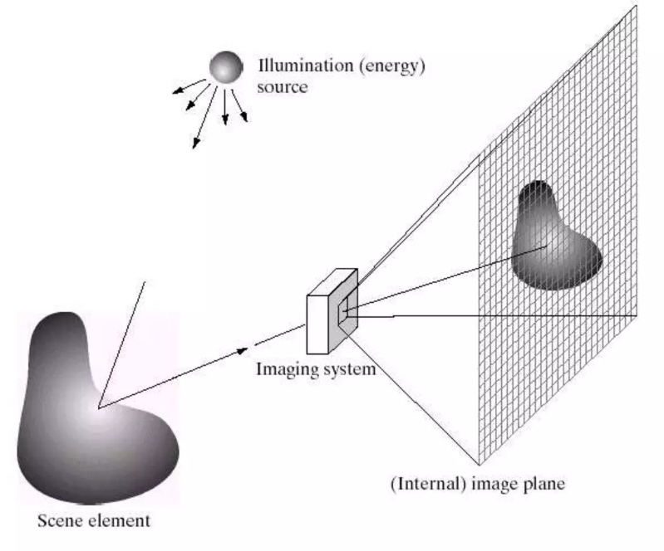
Understanding digital images
Image Formation

Slide 4
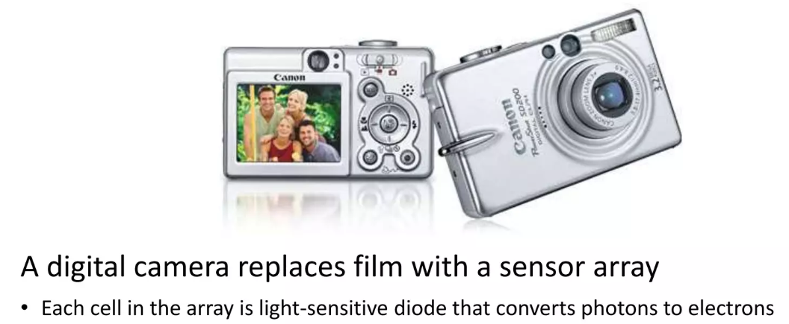
Understanding digital images
Digital Camera

Slide 5
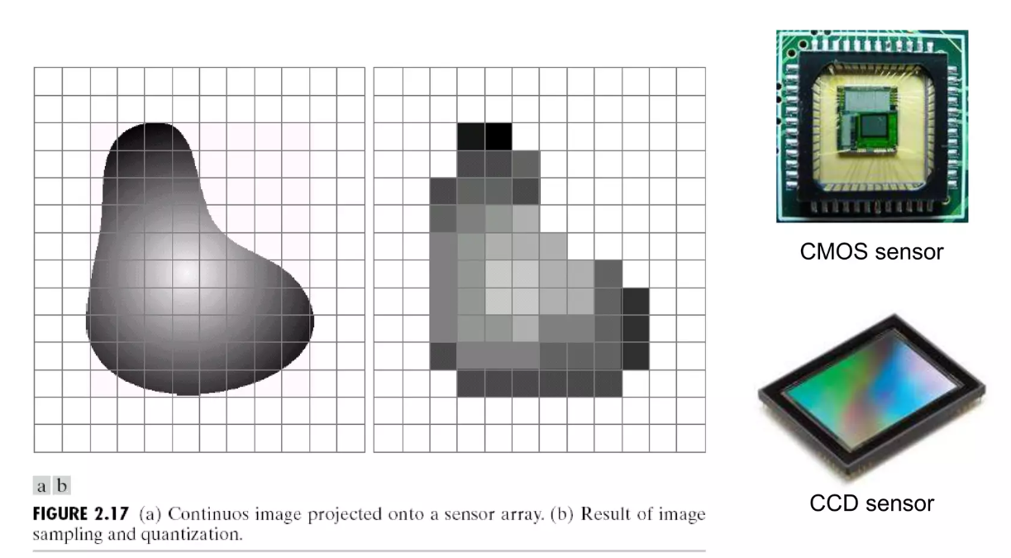
Understanding digital images
Sensor Array

Slide 6
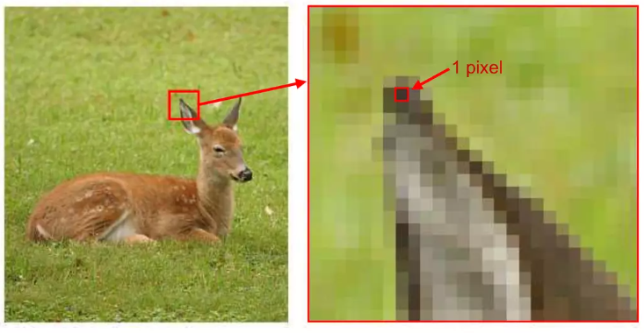
Understanding digital images
Pixel

Slide 7
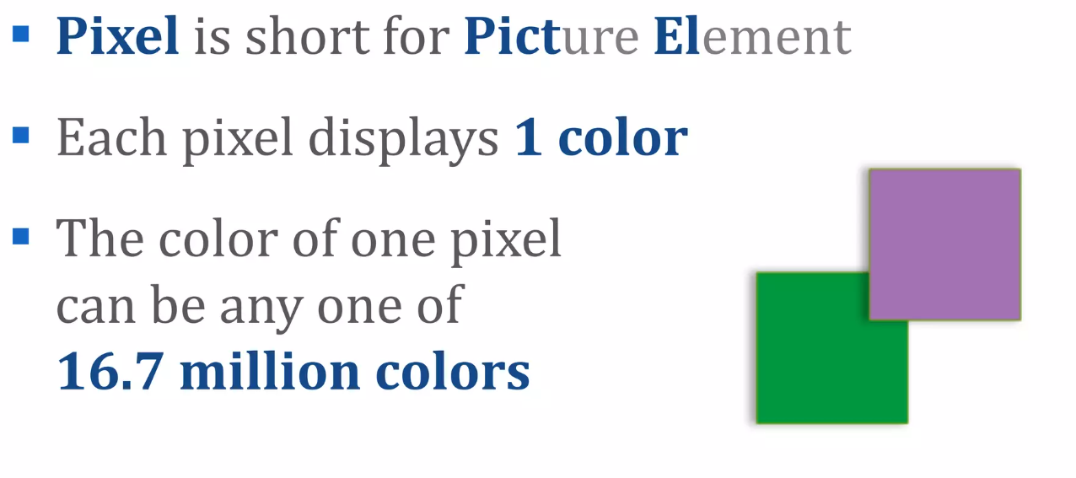
Understanding digital images
Pixel

Slide 8
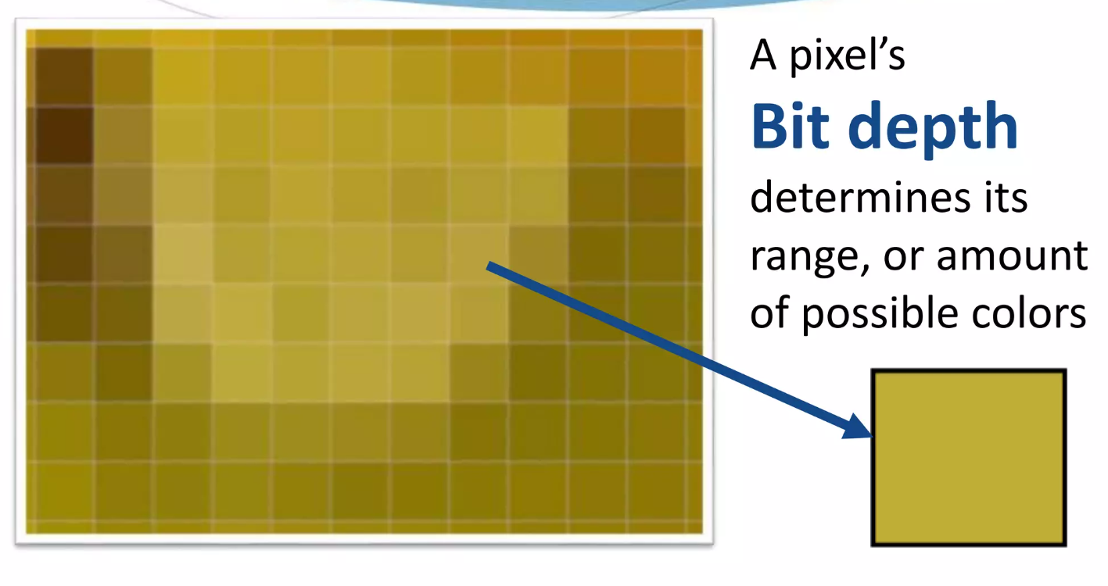
Understanding digital images
Pixel

Slide 9
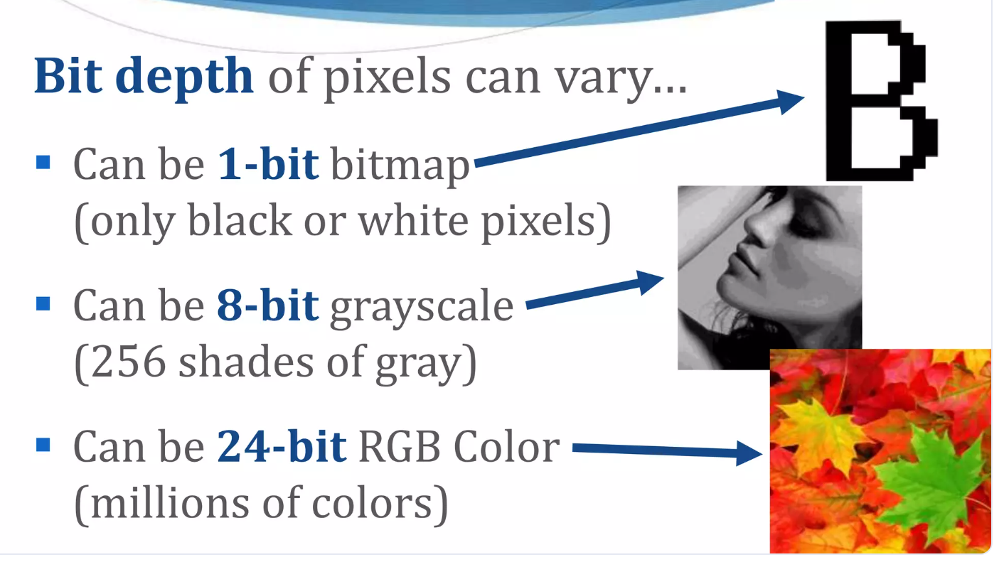
Understanding digital images
Pixel

Slide 10
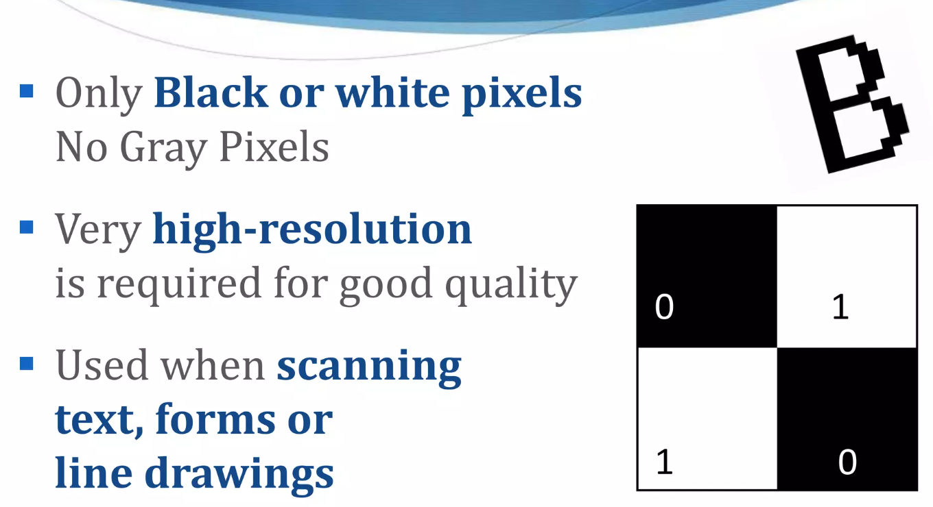
Understanding digital images
Pixel : 1 bit – Bitmap (Binary)

Slide 11
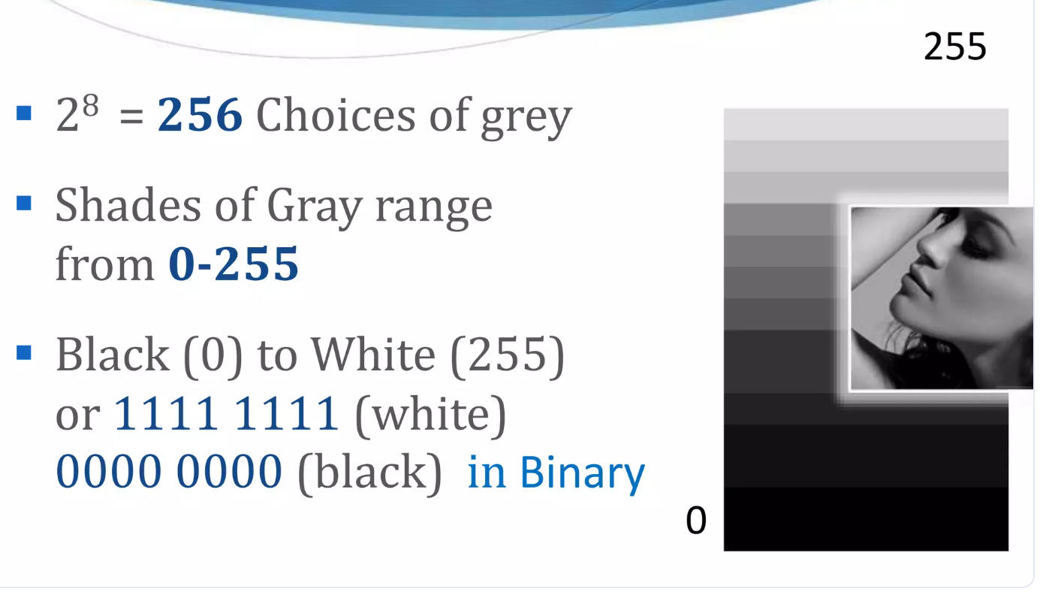
Understanding digital images
Pixel : 8 bit - Grayscale

Slide 12
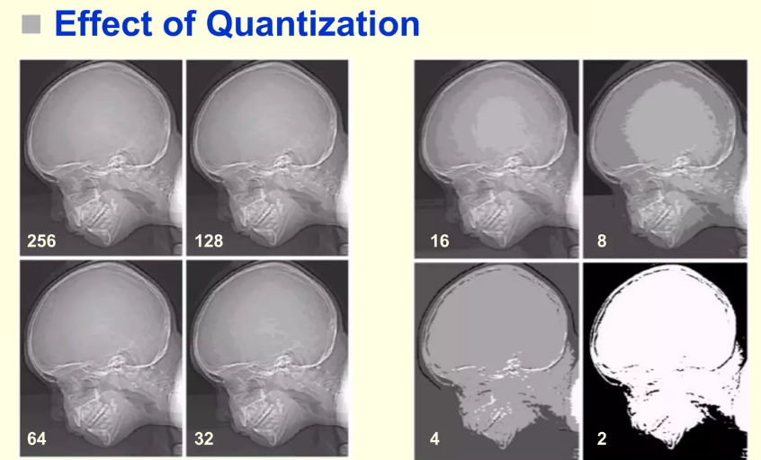
Understanding digital images

Slide 13
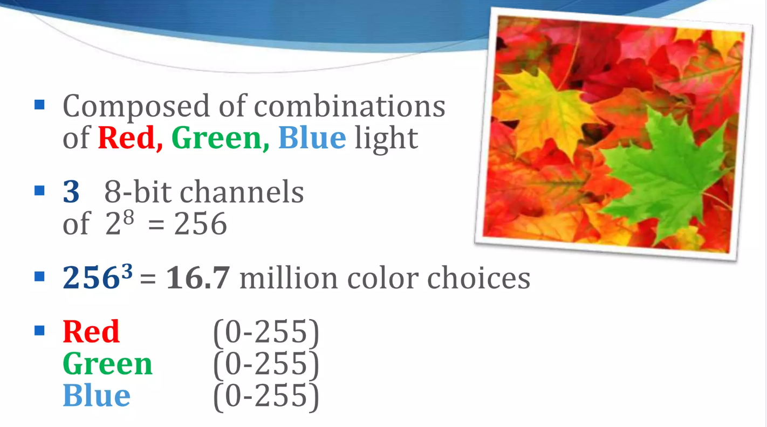
Understanding digital images
Pixel : 24 bit – Full Color - RGB

Slide 14
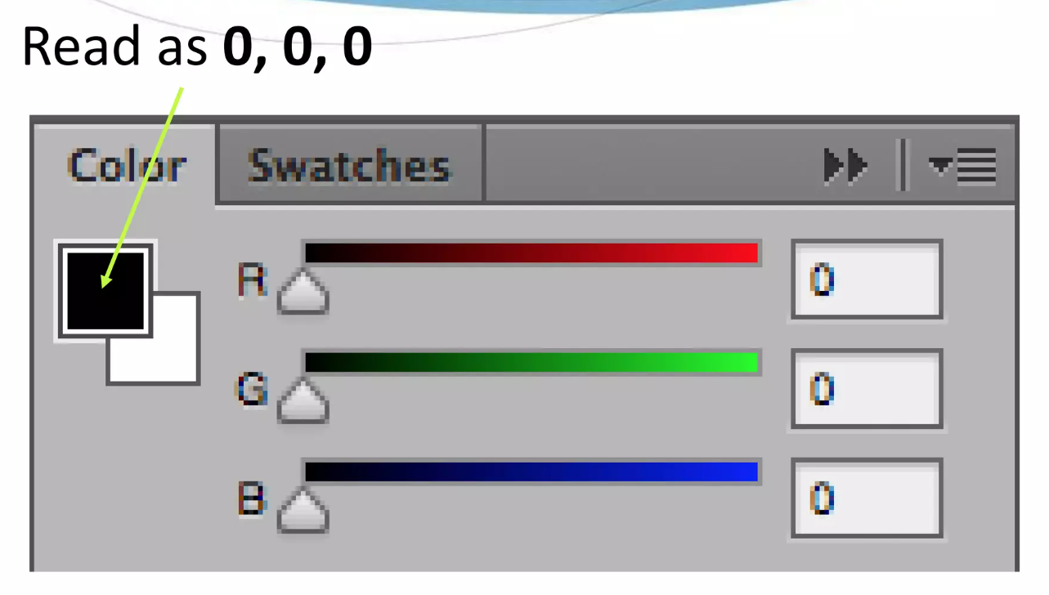
Understanding digital images
Pixel : 24 bit – RGB Color Slider

Slide 15
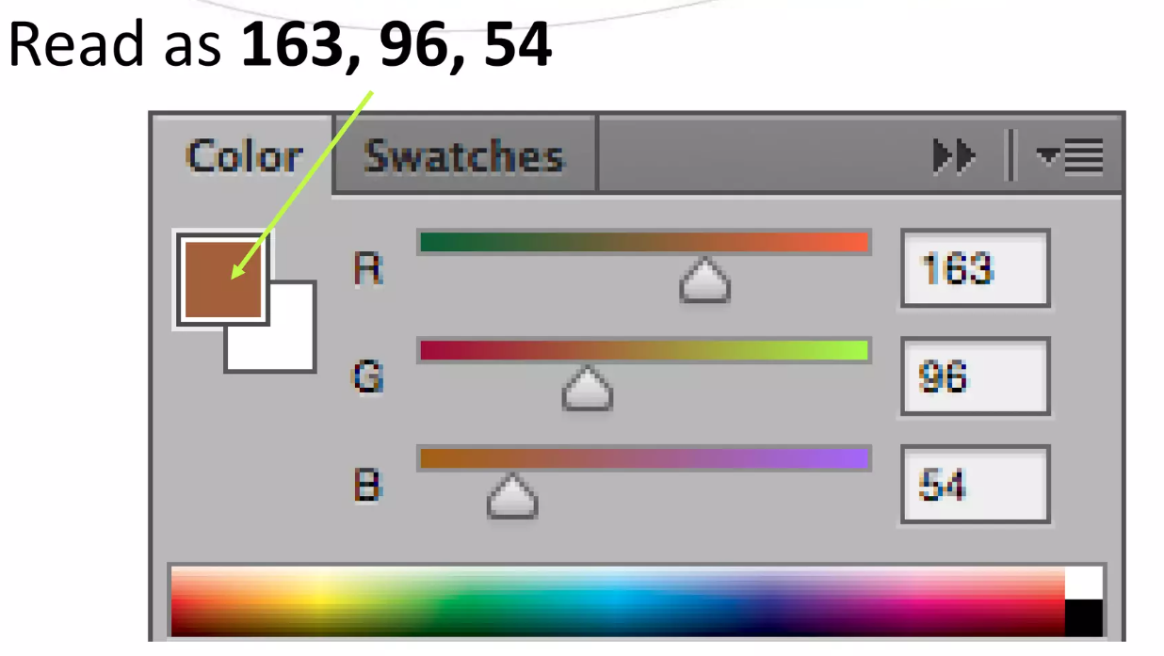
Understanding digital images
Pixel : 24 bit – RGB Color Slider

Slide 16
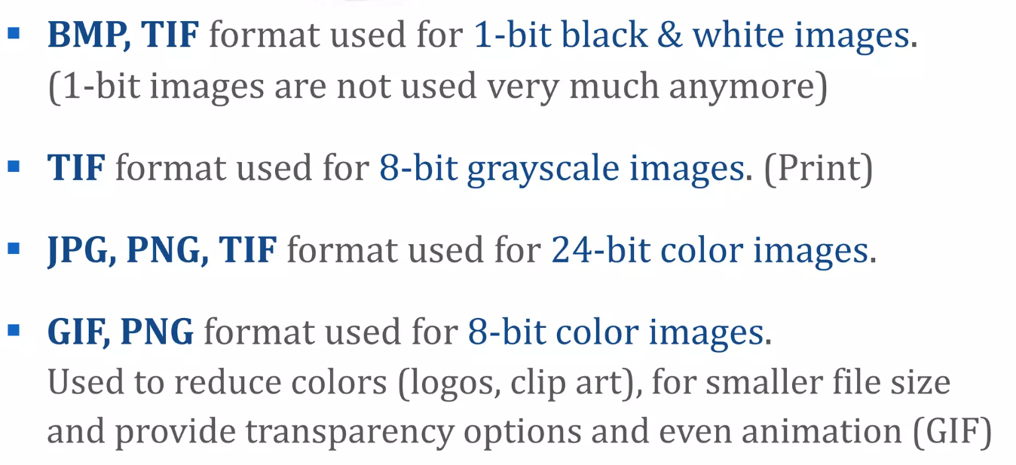
Understanding digital images
Image format

Slide 17
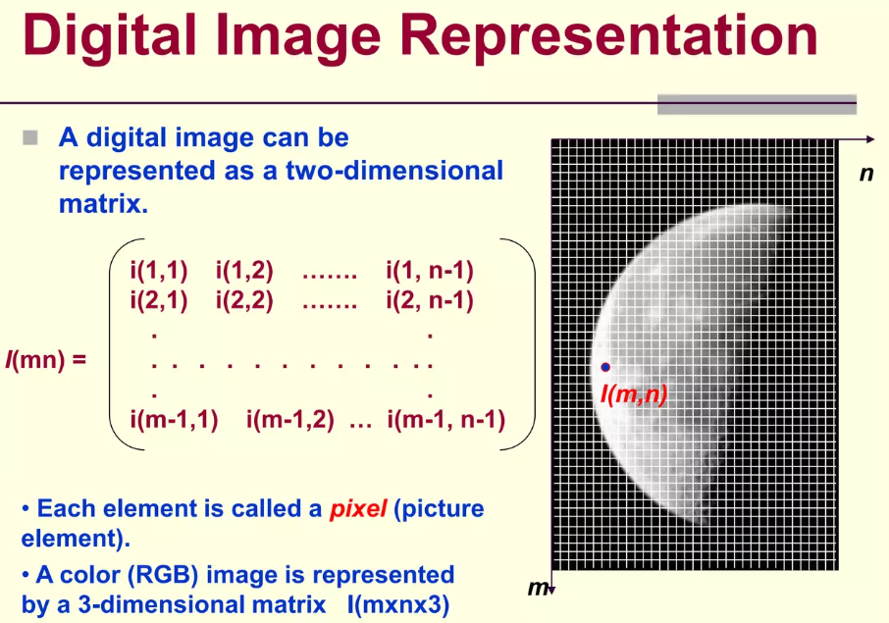
Understanding digital images

Slide 18
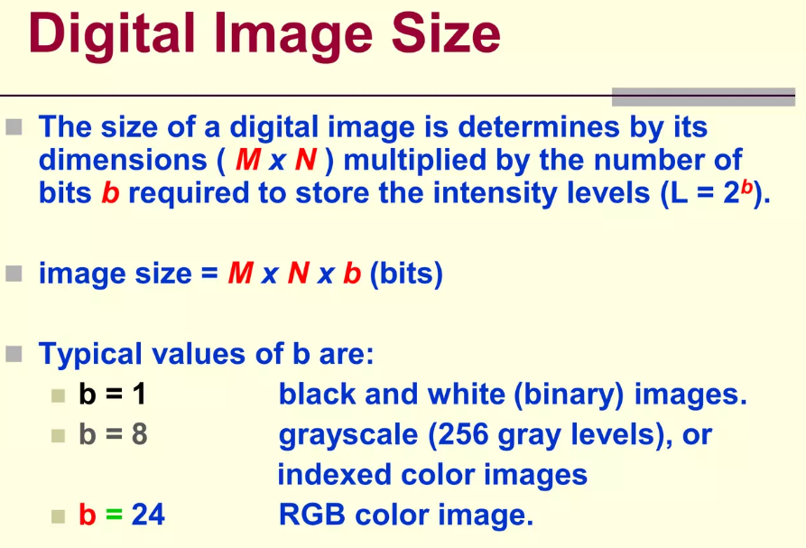
Understanding digital images

Slide 19
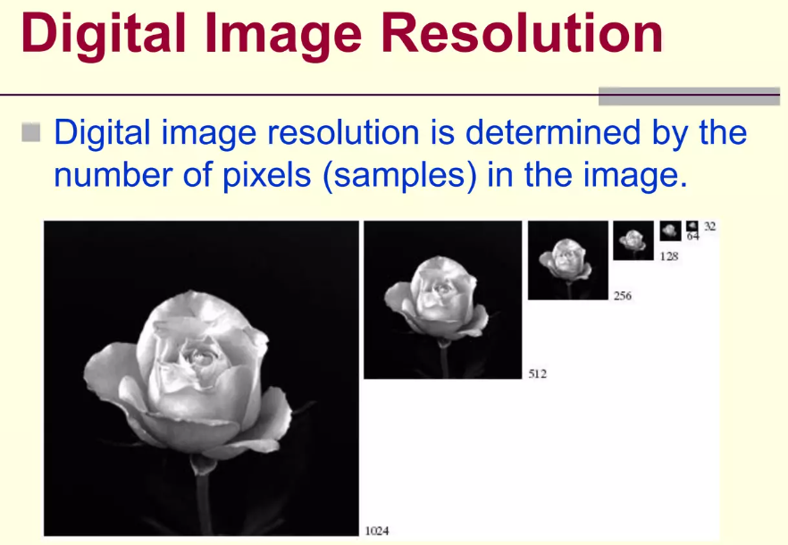
Understanding digital images

Slide 20
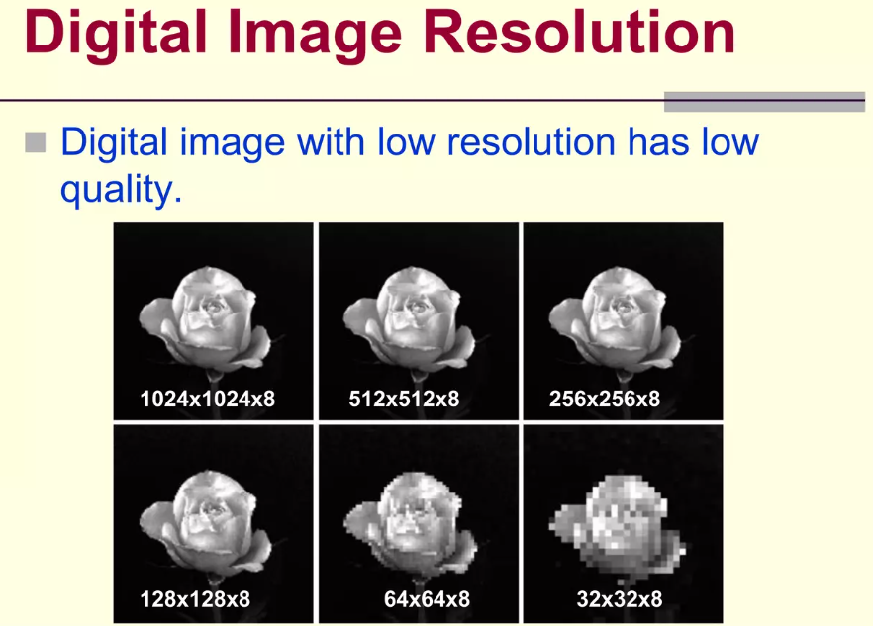
Understanding digital images

Slide 21
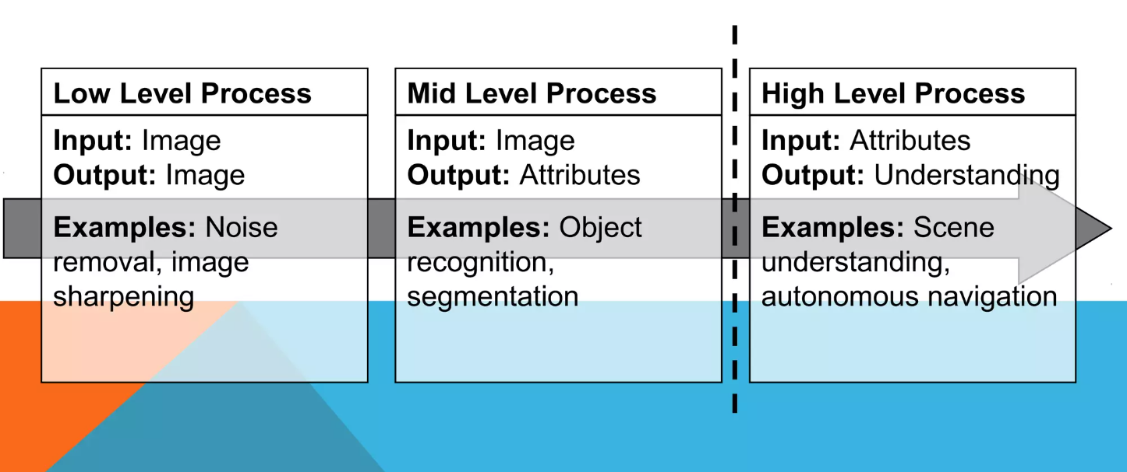
Understanding digital images
From Image Processing to Computer Vision

Slide 22
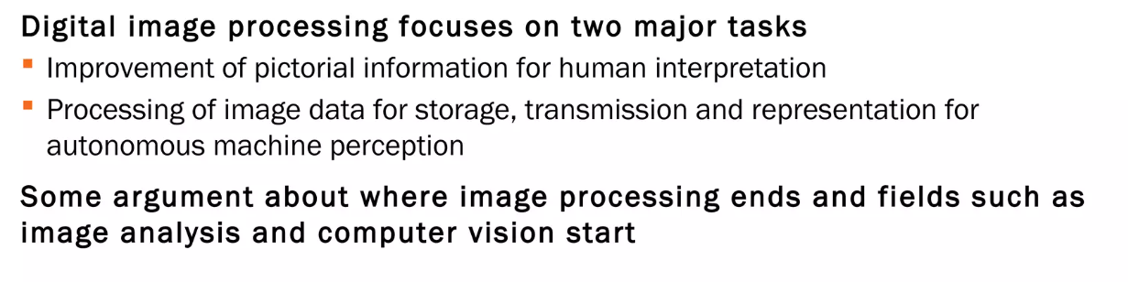
Understanding digital images
From Image Processing to Computer Vision

Slide 23
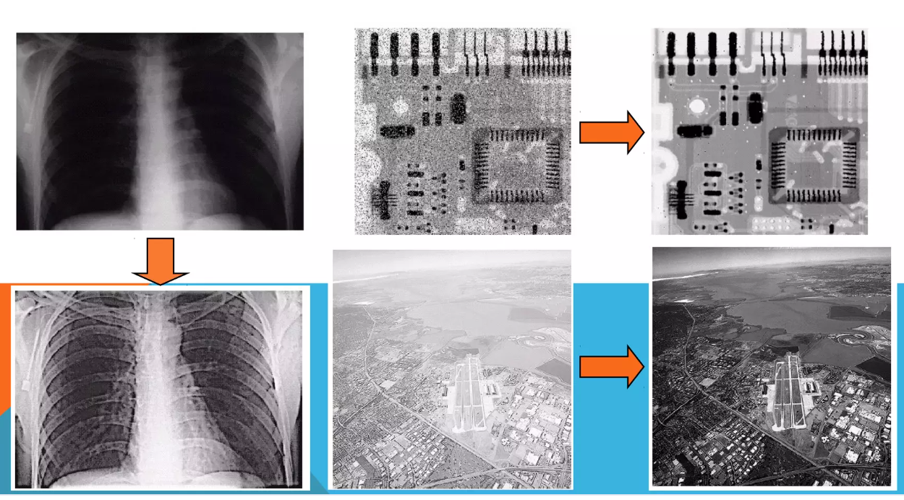
Understanding digital images
Image Processing

Slide 24
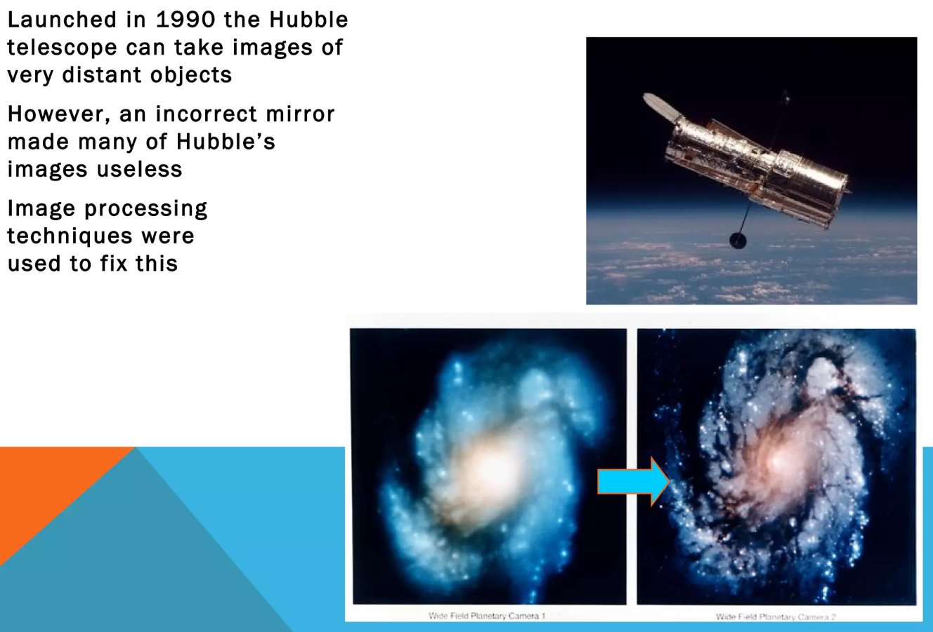
Understanding digital images
Image Processing : The HUBBLE TELESCOPE

Slide 25
Exercices
See Jupyter Notebook Chapter 2

Slide 26
https://fr.slideshare.net/slideshow/computer-vision-crash-course/56616946#39
https://fr.slideshare.net/slideshow/lecture-6computer-vision-features-descriptors-matching/238110848
https://homes.cs.washington.edu/~shapiro/EE596/notes/Descriptors.pdf

Slide 27
https://fr.slideshare.net/slideshow/image-segmentation-204910894/204910894
https://fr.slideshare.net/slideshow/image-segmentation-ppt/12322013

Slide 28
https://fr.slideshare.net/slideshow/an-introduction-to-machine-learning-and-how-to-teach-machines-to-see-a-presentation-from-tryolabs/149471493
Describe ML **
https://fr.slideshare.net/slideshow/modern-machine-vision-from-basics-to-advanced-deep-learning-a-presentation-from-deep-netts/250366942
https://fr.slideshare.net/slideshow/machine-learning-with-python-machine-learning-algorithms-machine-learning-tutorial-simplilearn/90036074?from_search=51&_gl=1*1koh12o*_gcl_au*MTQzOTQ1Mzk4OS4xNzI4NDkzOTEx
https://fr.slideshare.net/slideshow/knearest-neighborknn/264679060
https://fr.slideshare.net/slideshow/machinelearningazcoursedownloadableslidesv15pdf/256194090?from_search=41&_gl=1*1dye894*_gcl_au*MTQzOTQ1Mzk4OS4xNzI4NDkzOTEx
https://fr.slideshare.net/slideshow/what-is-machine-learning-machine-learning-basics-machine-learning-algorithms-simplilearn/87925925?from_search=174&_gl=1*1587ub9*_gcl_au*MTQzOTQ1Mzk4OS4xNzI4NDkzOTEx

Slide 29
https://fr.slideshare.net/slideshow/convolutional-neural-networks-cnn/264678891
Object detection adn segmentation using DL
https://fr.slideshare.net/slideshow/object-detection-and-instance-segmentation-238765186/238765186
https://fr.slideshare.net/slideshow/support-vector-machine-249594781/249594781
https://fr.slideshare.net/CharlesVestur/building-a-performing-machine-learning-model-from-a-to-z
https://fr.slideshare.net/slideshow/data-visualization-in-exploratory-data-analysis/231492108
EDA
https://fr.slideshare.net/slideshow/edapptx-255247021/255247021
https://fr.slideshare.net/slideshow/visualizations-in-exploratory-data-analysis/235714845

Slide 30
https://fr.slideshare.net/slideshow/computer-vision-147922238/147922238?from_search=9&_gl=1*4w44ae*_gcl_au*MTQzOTQ1Mzk4OS4xNzI4NDkzOTEx
https://fr.slideshare.net/slideshow/an-introduction-to-machine-learning-and-how-to-teach-machines-to-see-a-presentation-from-tryolabs/149471493?from_search=33&_gl=1*gljnn6*_gcl_au*MTQzOTQ1Mzk4OS4xNzI4NDkzOTEx
https://fr.slideshare.net/slideshow/bmva-ss-2014breckonml/36786012?from_search=59&_gl=1*cmwcpq*_gcl_au*MTQzOTQ1Mzk4OS4xNzI4NDkzOTEx

Slide 31
https://fr.slideshare.net/slideshow/exploratory-data-analysis-satyajitpdf/258255915?from_search=7&_gl=1*19ktc30*_gcl_au*MTQzOTQ1Mzk4OS4xNzI4NDkzOTEx
EDA
https://fr.slideshare.net/slideshow/machine-learning-splitting-datasets/79767442
https://fr.slideshare.net/slideshow/ml5-svm-andkernels/132216300?from_search=13&_gl=1*1jzvi7c*_gcl_au*MTQzOTQ1Mzk4OS4xNzI4NDkzOTEx
https://fr.slideshare.net/slideshow/random-forest-algorithm-random-forest-explained-random-forest-in-machine-learning-simplilearn-91647398/91647398?from_search=4&_gl=1*8uq8n5*_gcl_au*MTQzOTQ1Mzk4OS4xNzI4NDkzOTEx
https://fr.slideshare.net/slideshow/pca-and-lda-in-machine-learning/86175565?from_search=41&_gl=1*vysf2e*_gcl_au*MTQzOTQ1Mzk4OS4xNzI4NDkzOTEx

Slide 32
https://fr.slideshare.net/slideshow/deep-learning-for-computer-vision-intro/232160486
https://fr.slideshare.net/slideshow/grokking-techtalk-21-deep-learning-in-computer-vision/81351896?from_search=15&_gl=1*kemet1*_gcl_au*MTQzOTQ1Mzk4OS4xNzI4NDkzOTEx
https://fr.slideshare.net/slideshow/deep-learning-for-computer-vision-day-3-study-jams-gdsc-unsripptx/266334066?from_search=17&_gl=1*4tc2k0*_gcl_au*MTQzOTQ1Mzk4OS4xNzI4NDkzOTEx

